Slide 1


Slide 2
Group Member
Ayesha Nasser
Amen Fatima
Amina Iqbal
Amreen Mumtaz
Sharfa Javaid

Slide 3

Pressentation
Jewelry Management System

Slide 4
Introduction
The jewelry Management System is a comprehensive software solution designed to streamline the operations of jewelry stores wholesalers and manufactures the system aims to efficiently manage inventory sale customer relationships and day-to-day activities ultimately enhancing business productivity and profitability

Slide 5
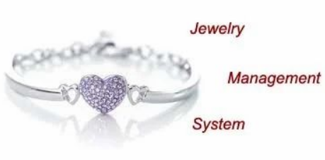

Slide 6
objective
Enhancing customer satisfaction
Increasing sales and revenue
Improving inventory management
Reducing operational costs
Simplifying daily operation
Ensuring data security and integrity

Slide 7
Scope
Artificial Intelligence
Security Enhancements
Big data analytics
Cloud-based solution

Slide 8
Features
Sales Management
Customer Management
Order Management
Point of sale
Multi-location Support
Integration

Slide 9
Module
Inventory management
Sales management
Customer management
Finance management
Product management

Slide 10


Slide 11


